Slide 1
Legal Operations for beginners
Unbundling Of Legal Services

Slide 2
Innovation is Key
If your business is not constantly innovating, you are being left behind

Slide 3
What is Legal Ops and Why do you need it?
WHAT?
The basic definition of Legal Ops is bundling all tasks within Legal, which don‘t require a law degree to free up in-house lawyers to focus on legal work.
WHY?
Legal Departments and Law Firms are facing increasing challenges. Whilst pressure on costs and time is growing steadily, there is simultaneously an increase in the complexity of juridical work, in the legal inquiries from the business and in the demand for legal services.

Slide 4
How?
Technology Management
Project Management
Business Intelligence
Information Governance
Training
Matter Management
Knowledge Management
Legal Research
Firm and Vendor Management
Financial Management
Notes:
Financial Management - Legal ops also plans legal spend, creates budgets, implements and monitors e-Billing for legal services, manages accruals, and forecasts expenses, among other things.
Unter dem Begriff Matter Management versteht man den Prozess des Verwaltens einer Legal Matter.
Knowledge management - Legal ops also engages in knowledge management by facilitating knowledge hubs, creating templates, and preventing knowledge los.
Training - Legal ops also creates training resources for new hires and facilitates career development and upskilling.
Firm and Vendor Management - Legal ops choose the right firms – performing - due diligence, handling contract management, and, overall, onboarding new vendors quickly. Beispiel: Legito.

Slide 5
What Skills does a Legal Ops Employee Need?
Tech savvy (or digital native) with knowledge of data analytics
Excellent project management skillset
Strong analytical skills, ability to challenge the status quo, continuous improvement mindset
A strong understanding of the core business and processes (especially for Leaders)
Academic degree in IT and/or Legal (no must)

Slide 6
What Types of Legal Ops employees exist?
Legal Ops Manager - supports the team around tasks like vendor management, budgeting and change management
Legal Ops Specialist – expert, who executes on departmental projects and goals
Legal Ops Analyst – expert in analytics and KPIs
Head of Legal Ops (sometimes also Legal Ops Manager)
Notes:
According to Association of Corporate Counsel (ACC) on average Legal Ops Departments contain up to 4 employees.

Slide 7
My Topics for Today – Examples:
Contract and template management: Carizma, Luminance, Kira, DocuSign CLM
Dashboarding – Power BI, Tableau, Qlikview
E-Signature – examples: DocuSign, Adobe Acrobat Sign, A-Trust
Information Governance – Iron Mountain, Filerskeepers
Legal Chatbot – Custom build
Notes:
Carizma is the software BI is using paired with a front-end tool for template creation and DocuSign for e-signing of contracts.
Kira Systems asserts that its software is capable of performing a more accurate due diligence contract review by searching, highlighting, and extracting relevant content for analysis.
Luminance is a cloud-based practice management solution that helps law firms prepare litigation cases, manage client records and maintain legal databases.

Slide 8
Live Presentation

Slide 9
Contract Management
Maximising Financial Benefit | Minimising Risk | Increasing Efficiency | Increasing Transparency & Quality
Making maximum use of conditions granted Avoiding financial damage, e.g. damage incurred through missed payment receipts or options not utilized | ensuring active risk management in the process as a whole observing legal and company guidelines in respect of compliance | establishing a standardized procedure for creating a high amount of contracts increasing the efficiency of the process from the initial contract phase through completion to termination and conclusion | establishing a transparent and structured overview and thus gaining information rapidly about all parties involved increasing automation

Slide 10
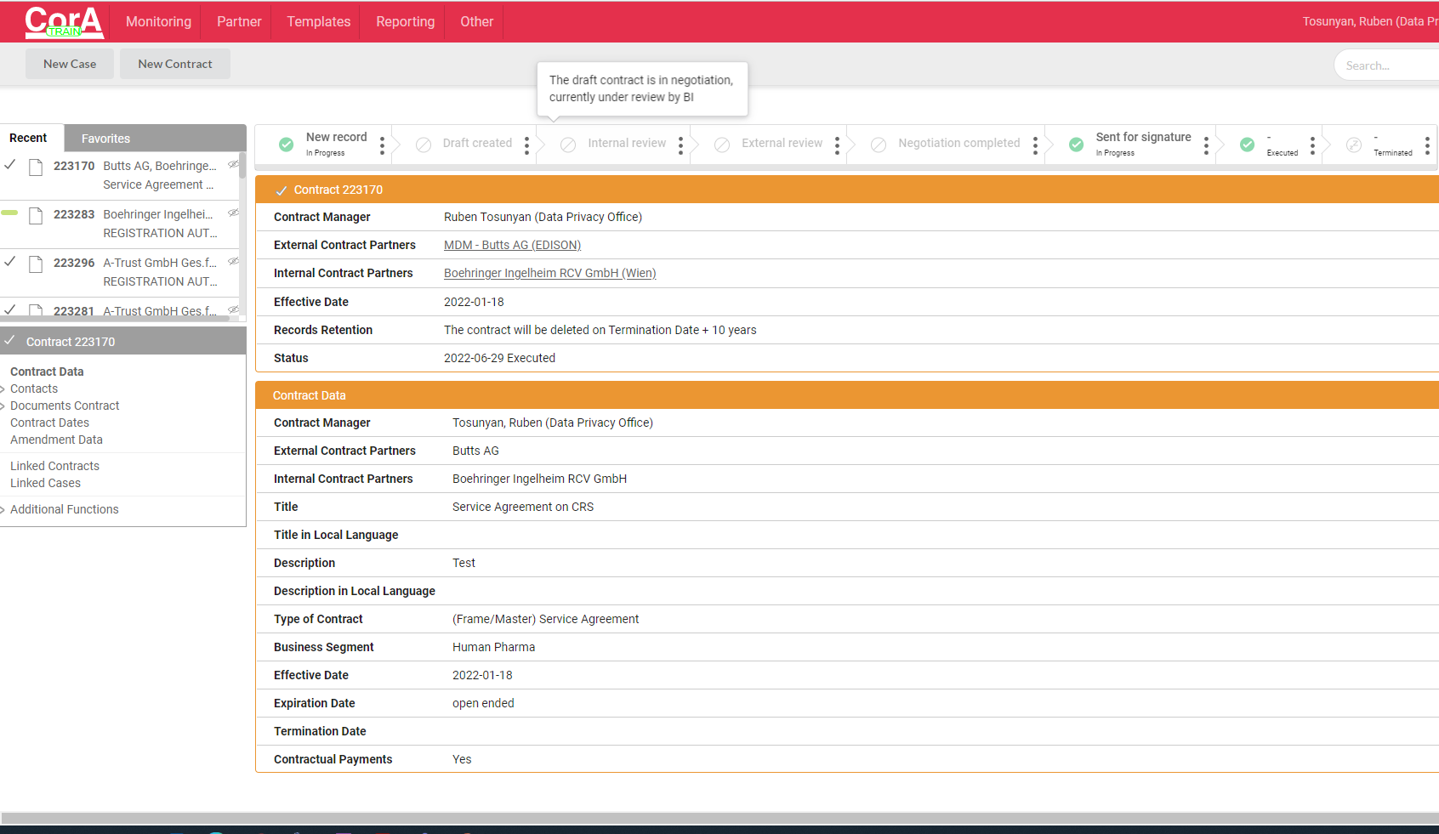
Carizma and template management
Notes:
For all the systems shown here and below – important is to establish not only the particular system within the company or the law firm, but also a training and support system, which would be sustained by the company.

Slide 11
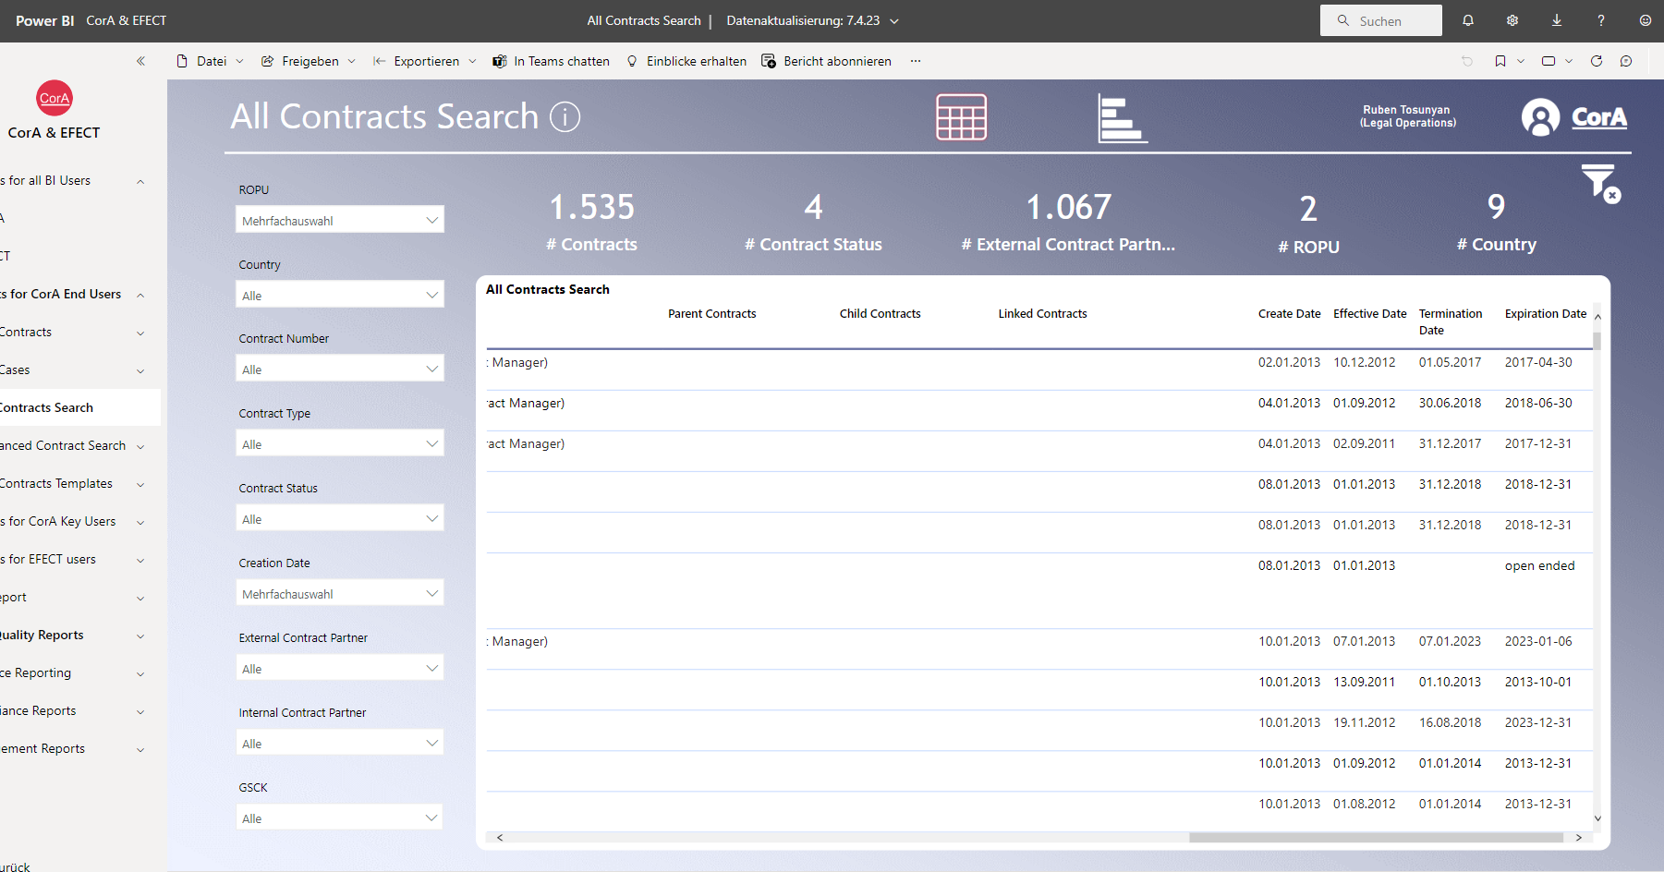
Dashboarding – Power BI

Slide 12
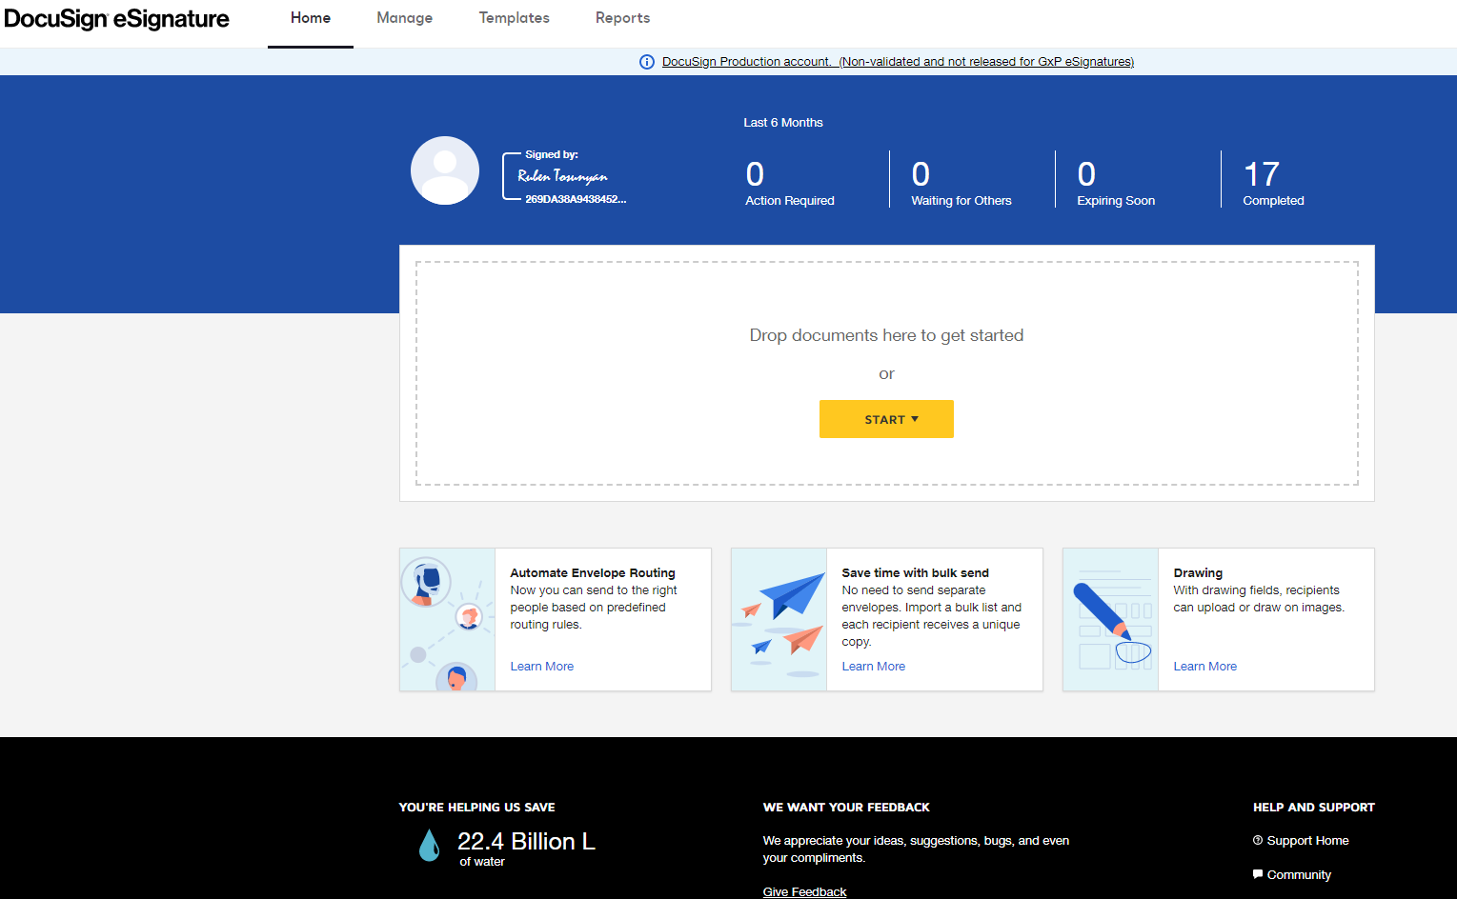
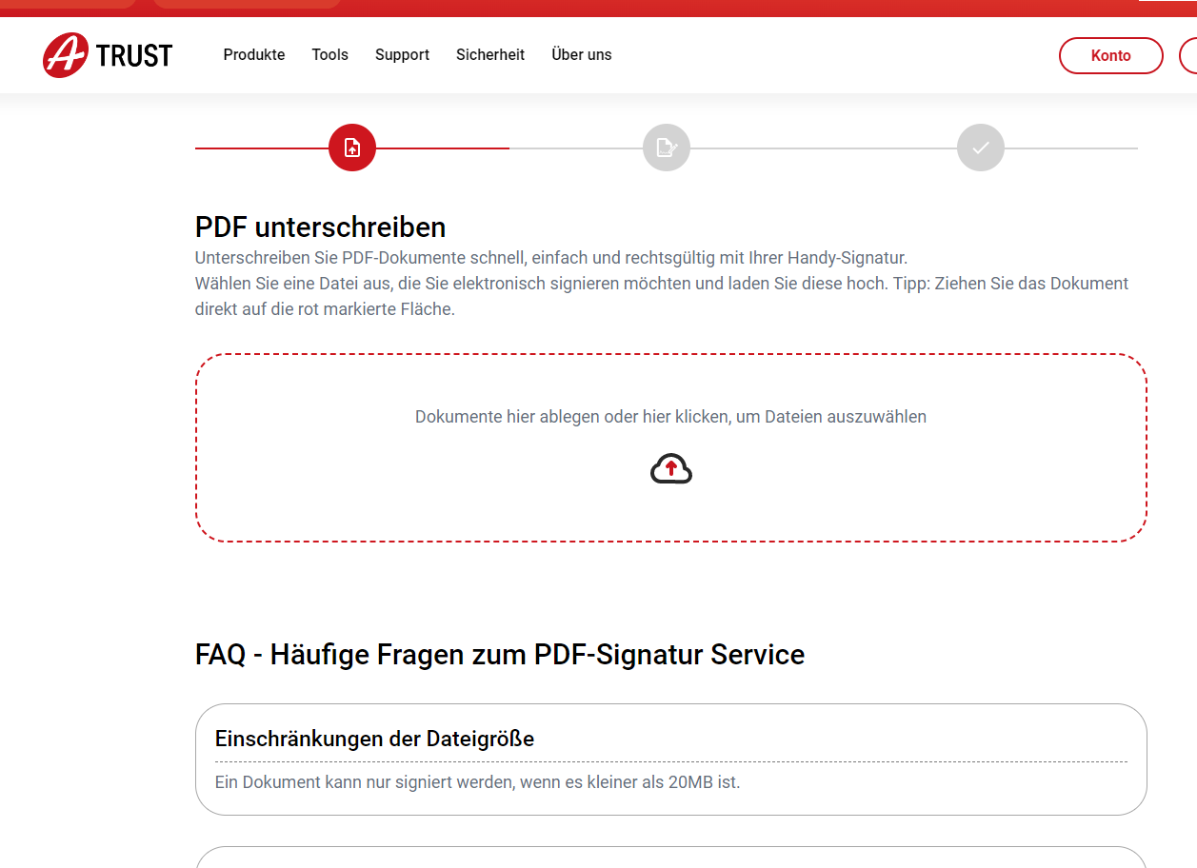
E-Signing - DoCuSign

Slide 13
Information Governance
Information Governance is the governing body which helps the Business by creating a formal program and an accountability framework ensuring that the company is:
Complying with regulatory and legal requirements which state how long we have to retain records (e.g., Tax, Finance, GXP) and/or when we have to delete information (e.g., General Data Protection Regulation (GDPR)
Managing the complexity of our "information landscape" by optimizing information-related efficiencies and maximize the inherent value of the information
Classifying our information so that we can protect our records appropriately and minimize information-related risks (data breach)

Slide 14
Legal Chatbot – Live Demo

Slide 15
What are your needs/requirements?
Slido Questions:
What are the areas you are interested in?
What would be the biggest obstacles for the implementation?
What is the biggest leverage point in your firm/company?

Slide 16
Welche Bereiche benötigen Sie?
ⓘ Start presenting to display the poll results on this slide.

Slide 17
Wo sehen Sie das größte Hindernis für die Umsetzung in Ihrer Struktur?
ⓘ Start presenting to display the poll results on this slide.

Slide 18
Was ist der größte Hebel in Ihrer Kanzlei/Unternehmen?
ⓘ Start presenting to display the poll results on this slide.

Slide 19
Speaker – Ruben Tosunyan
Legal Data Manager
Member of Legal Ops BI RCV
Boehringer Ingelheim RCV GmbH & Co KG
ruben.tosunyan@boehringer-ingelheim.com
Phone: +436509137965

Slide 20
Questions?

